Slide 1
TELCO CHURN PREDICTION
BINARY CLASSIFICATION
Machine learning portfolio
DEREK RODRIGO SÁNCHEZ SEGUAME

Slide 2
Task Definition
EDA
Model and Results

Slide 3
01
Task Definition

Slide 4
Task Definition
Problem statement | Customer churn in telco
TeleConnecta Solutions is a new telecommunications provider in Mexico that has successfully achieved its initial market objectives. Their main focus is individual customers and the’ve succesfuly executed an aggressive market expansion strategy.
However, the company now faces a higher-than-expected churn rate, directly affecting profitability and competitiveness.
To tackle this challenge, TeleConnecta plans to implement a Machine Learning model as part of a data-driven strategy. This approach will enable the organization to identify at-risk customers, optimize retention efforts, and personalize offers—all powered by AI and built on the pillars of reproducibility, scalability, and data quality.
The available data for this project consists of the Telco Customer Churn dataset. By applying advanced analytical techniques, TeleConnecta aims to reduce churn, ensure regulatory compliance, and drive sustainable growth in Mexico's competitive telecommunications market.
4

Slide 5



Task Definition
Communications AND Customer churn | Risk management powered by machine learning
Our client
Pain point
Solution
TeleConnecta is a mexican Fintech
Their target market are SMEs
They’ve had an expansive strategy to achieve market share goals
they are experiencing excessive defaults due to:
Its broad market reach
Unsound retention strategy
This generates problems in:
Profitability
Competitveness
Using the provided dataset, a Machine Learning Binary Classification Model will be generated
This model will evaluate each client and estimate the churn possibility
Note:
5

Slide 6
02
Exploratory Data Analysis

Slide 7
Overview | a dataset primarily composed by categorical features
EXPLORATORY DATA ANALYSIS
# of Features | By data type
# of Categorical Features | By # of unique observations
 | #Features
Numerical | 3
Categorical non-ordinal | 19
Total | 21
 | Two Unique Obs | Three Unique Obs | Four+ Unique Obs
#Features | 7 | 9 | 3
Categorical Features Distributions
Target
Features
Churn
Senior
Dependents
Phone
Contract
Note:
7

Slide 8
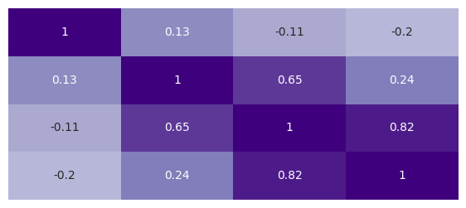
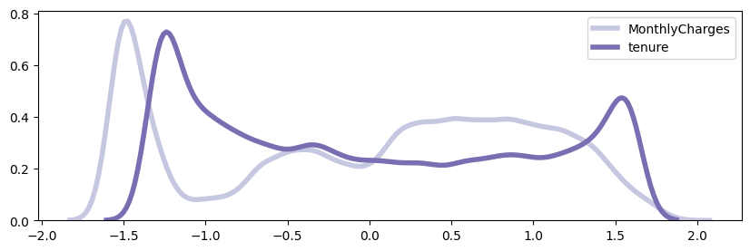
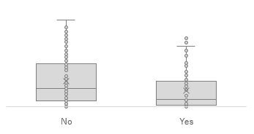
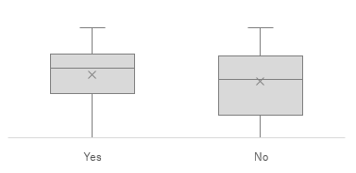
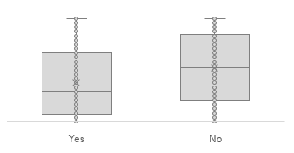
Numerical variables | heatmap, distributions and boxplots
EXPLORATORY DATA ANALYSIS
Correlation Matrix Heatmap
Distribution Graph
Churn
Monthly
Total Charge
Tenure
Churn
Monthly
Total Charge
Tenure
Box plot | by feature
Tenure
Monthly
Total Charge
Churn
8

Slide 9
03
Model Selection and Results

Slide 10




Model selection and results
Model selection | Gradient boosting a logistic regression performed roughly the same but better than k-nn
Model
Tuning
Parameters
Metrics
Gradient Boosting
Randomized Search
learning rate = 0.01
n_estimators = 100
Max_Depth = 4
Accuracy: 76%
Precision: 73%
AUC ROC: 83%
Random Forest
Randomized Search
n_estimators = 427
max_depth = 17
Accuracy: 78%
Precision: 67%
AUC ROC: 84%
SVM
Grid Search
C = 1.0
kernel = rbf
Accuracy: 78%
Precision: 66%
AUC ROC: 79%
Logistic Regression
Grid Search
L1 Regularization
C = 5.2
Accuracy: 79%
Precision: 66%
AUC ROC: 84%
Note:
10

Slide 11
Model selection and results
FROM DATA TO ACTIONABLES | the power of data to provide business solutions
Gradient Boosting has the best precision, but…
Findings
Simplier models like Logistc Regression adhere more to regulation and have easier interpretations
Considering the client’s concern of regularatory standards, Logistic Regression might be suitable
Conclusions
Next steps
Final Thoughts
Newly acquired customers have the highest possibility of churn
It is important to have a reliable risk model
Despite several tests and treatment, dataset might be noisy and affect predictive power
Improving model performance
Discovery process with the client to ask for a dataset with:
More observations
More features
11

Slide 12
Model selection and results
Model selection | Gradient boosting a logistic regression performed roughly the same but better than k-nn
Model
Tuning
Parameters
Metrics
K-NN
Randomized Grid Search
11 nearest neighbors
Accuracy: 60%
Precision: 61%
AUC ROC: 63%
Logistic Regression
Randomized Grid Search
L1 regularization
C = 0.1
Accuracy: 64%
Precision: 65%
AUC ROC: 68%
Gradient Boosting
Randomized Grid Search
Leafs = 2
Max Depth = 3
Learning rate = 0.1
Accuracy: 64%
Precision: 69%
AUC ROC: 68%
Note:
12

